Slide 1
CSCE 823 In Class Day 05
ANN Training: Backpropagation
Live Synchronous session

Slide 2
Agenda
Backpropagation Review
Learning Activity: ANNs
Break
Q&A

Slide 3
Two-way Propagation Overview
Step 0: randomly select the kth observation: x^{k}
Step 1: Feed x^{k} Forward to produce output y^{k}
Step 2: Propagate Errors backwards to adjust weights
Input
Hidden Layer
Output Layer

Slide 4
Backprop Intuition
Forward prop makes a prediction
The amount of error in the prediction should be accounted for by adjusting model parameters (weights and biases)
For each observation, the amount of error a node is responsible for is related to the amount of activation it had on that input
The amount of change to a node parameter will be affected by the gradient of the activation with respect to the parameter AT the value of the activation induced by the input

Slide 5
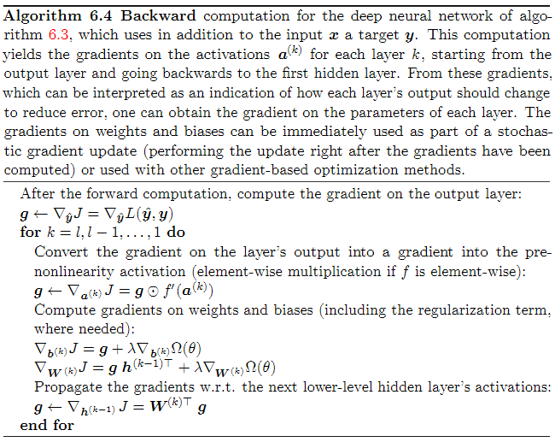



Backpropagation Algorithm
$$\text{SHAPE} b:{ b}_{\left[from\right],\left[1\right]}$$
$$\text{SHAPE} w:w_{\left[to\right],\left[from\right]}$$
$$\text{SHAPE} h:{ h}_{\left[from\right],\left[1\right]}$$
Gradient of the output. (note: g will be used to store temporary gradients as we work backwards)
Work backwards, counting down from last layer to first layer
Determine gradient for current layer k. Note: this is a Hadamard (element-wise) product
Include regularization penalty on the biases and weights in the next calculation
Determine update to biases for this layer (save for later)
Determine update to weights for this layer (save for later)
Determine gradient for previous layer (used in next iteration).

Slide 6
Learning Activity - Backprop (Breakout Groups, 20 min)
Goal: Using a 2-layer ANN, train to solve XOR
Review the backpropagation training routine for the network (Deep Learning alg. 6.4)
Student Coding:
Implement the function for the derivative of a Sigmoid and a ReLU
Implement loss functions for the network: Binary Cross Entropy and MSE
Train the network to model XOR & evaluate
Design: [2 (or more) nodes with ReLU or sigmoid in hidden layer; 1 output sigmoid]
Other Parameters (learning rate, decay, max epochs)

Slide 7
Break

Slide 8
Q&A

Slide 9
Backup Slides for Backprop

Slide 10




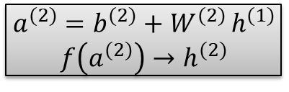




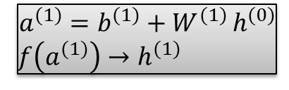







Forward Notation (Two layer network: l ∈ {1,2} )
$$\text{SHAPE} b:{ b}_{\left[from\right],\left[1\right]}$$
$$\text{SHAPE} w:w_{\left[to\right],\left[from\right]}$$
y₁
y₂
$$\text{SHAPE} h:{ h}_{\left[from\right],\left[1\right]}$$
Hidden Layer
Output Layer
Output
Input Layer
Nodes Indexed by j
Nodes Indexed by i
1
2
$$h_{1}^{(1)}$$
$$h_{1}^{(0)}$$
$$h_{2}^{(1)}$$
$$h_{1}^{(2)}$$
$$h_{2}^{(0)}$$
$$h_{3}^{(1)}$$
$$h_{2}^{(2)}$$
Features Indexed by m
$$h_{3}^{(0)}$$
1
2
3
4
$$h_{4}^{(1)}$$
$${W^{(2)}: w}_{j,i}$$
$${W^{(1)}: w}_{i,m}$$
$x→h^{(1)}$
$$a^{(1)}=b^{(1)}+W^{(1) }h^{(0)}$$
$f\left(a^{(1)}\right)→h^{(1)}$
$$a^{(2)}=b^{(2)}+W^{(2) }h^{(1)}$$
$$f\left(a^{(2)}\right)→h^{(2)}$$
When counting layers, don’t count the input
x₁
x₂
x₃

Slide 11

Learning Process: Overview for two layer network
Repeat this process over all observations:
Forward prop from training sample x^{k}
Determine loss from training sample x^{k}
Compute all gradients & updates: Backpropagation
Determine output layer node gradients & weight updates
Determine hidden layer node gradients & weight updates (using output layer node gradients)
Update all Weights & Biases:
Update all output layer weights & biases
Update hidden layer weights & biases
$$L\left(\hat{y} ,y\right)$$

Slide 12
1. Compute all gradients & weight updates: Backpropagation Algorithm
$$\text{SHAPE} b:{ b}_{\left[from\right],\left[1\right]}$$
$$\text{SHAPE} w:w_{\left[to\right],\left[from\right]}$$
$$\text{SHAPE} h:{ h}_{\left[from\right],\left[1\right]}$$
Gradient of the output. (note: g will be used to store temporary gradients as we work backwards)
Work backwards, counting down from last layer to first layer
Determine gradient for current layer k. Note: this is a Hadamard (element-wise) product
Include regularization penalty on the biases and weights in the next calculation
Determine update to biases for this layer (save for later)
Determine update to weights for this layer (save for later)
Determine gradient for previous layer (used in next iteration).

Slide 13

Step 1: Backprop Trace (1 of 2): Update gradients for output layer
General case with multiple output nodes
h^{(l)} is always output from layer l
j indexes output nodes, i indexes hidden nodes, m indexes input source (output from previous layer)
Output Layer gradients for node j:
Output layer weights
$$\text{activation} \text{at} \text{output} \text{node} j: a_{j}=Net_{j}=\sum_{i}{w_{j,i}^{(2)}h_{i}^{(1)}}$$
Inputs from hidden layer
$$\text{gradient} \text{at} \text{output} \text{node} j: g_{j}^{(2)}=∇_{y}L\left(\hat{y} ,y\right)⊙f′\left(a_{j}^{\left(2\right)}\right)$$
Derivative of activation function at output layer
Loss at output
$$\text{bias} \text{gradient} \text{for} \text{output} \text{node} j: ∇_{b^{(2)}}J=g_{j}^{(2)}$$
$$\text{weight} \text{gradient} \text{for} \text{output} \text{node} j: ∇_{W^{(2)}}J=g_{j}^{(2)}h^{\left(1\right)⊤}$$
Inputs from hidden layer

Slide 14
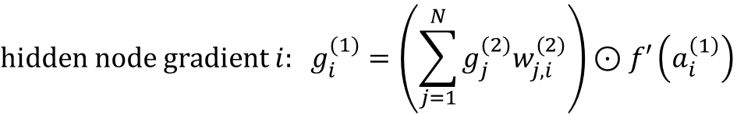
Step 1: Backprop Trace (2 of 2): Update gradients for hidden layer
General case with multiple output nodes
h^{(l)} is always output from layer l
j indexes output nodes, i indexes hidden nodes, m indexes input source
Hidden Layer update for node i
(output from previous layer
– which happens to be a feature vector in this example)
Hidden layer weights
$$\text{activation} \text{at} \text{hidden} \text{node} i: a_{i}=Net_{i}=\sum_{i}{w_{i,m}^{(1)}h_{m}^{(0)}=\sum_{m}{w_{i,m}^{(1)}}{ x}_{m}}$$
Feature values
$$\text{hidden} \text{node} \text{gradient} i: g_{i}^{(1)}=\left(\sum_{j=1}^{N}{g_{j}^{(2)}w_{j,i }^{(2)}}\right)⊙f′\left(a_{i}^{\left(1\right)}\right)$$
output layer weights
Derivative of activation function at hidden layer
gradient from output layer
$$\text{bias} \text{gradient} \text{for} \text{hidden} \text{node} i: ∇_{b^{(1)}}J=g_{i}^{(1)}$$
$\text{weight} \text{gradient} \text{for} \text{hidden} \text{node} i: ∇_{W^{(1)}}J=g_{i}^{(1)}h^{\left(0\right)⊤}$=$g_{i}^{(1)}x_{m}$
Feature values

Slide 15
Step 2: Update weights
General case with multiple output nodes
h^{(l)} is always output from layer l, biases are 1
j indexes output nodes, i indexes hidden nodes, m indexes input source (output from previous layer)
Output Layer update for node j
Hidden Layer update for node i
Inputs from hidden layer
$$\text{bias} \text{update} \text{for} \text{output} \text{node} j:{ b_{j}^{\left(2\right)}=b_{j}^{\left(2\right)}+α\left(t\right)∇}_{b^{(2)}}J={b_{j}^{\left(2\right)}+α\left(t\right)g}_{j}^{(2)}$$
$$\text{weight} \text{update} \text{for} \text{output} \text{node} j: {W_{i,j}}^{\left(2\right)}={W_{i,j}}^{\left(2\right)}+α\left(t\right)∇_{W^{(2)}}J ={{W_{i,j}}^{\left(2\right)}+α\left(t\right)g}_{j}^{(2)}h^{\left(1\right)⊤}$$
Feature values
$$\text{bias} \text{update} \text{for} \text{hidden} \text{node} i:b_{i}^{\left(1\right)}=b_{i}^{\left(1\right)}+α\left(t\right)∇_{b^{(1)}}J={b_{i}^{\left(1\right)}+α\left(t\right)g}_{i}^{(1)}$$
$$\text{weight} \text{gradient} \text{for} \text{hidden} \text{node} i:$$
$${{W_{i,m}}^{\left(1\right)}={W_{i,m}}^{\left(1\right)}+α\left(t\right)∇}_{W^{(1)}}J={{W_{i,m}}^{\left(1\right)}+α\left(t\right)g}_{i}^{(1)}h^{\left(0\right)⊤}={W_{i,m}}^{\left(1\right)}+α\left(t\right)g_{i}^{(1)}x_{m}$$

